Slide 1
TE 271: Analog Communication Systems Lecture 2 Examiner: M. S. Ellis, PhD smellis.coe@knust.edu.gh 057 904 7591
September 11th , 2016

Slide 2
Reference material
A. Yadav, “Analog Communication Systems”, University Science Press, New Delhi, 2008.
S. Sharma, “Communication Engineering”, First Ed., S.K. Kataria & Sons, New Delhi, 2011.
T. G. Thomas, “Analog Communication”, McGraw hill, New Delhi, 2007.

Slide 3
Intro to Basic Comm. Systems….Modulation
Systems are designed to allow many individual messages to be transmitted over a single communication channel
A method by which this can be achieved is called Multiplexing
In multiplexing, baseband signals (voice, audio, video) of same frequency are shifted on different frequency locations (frequency translation) within the total bandwidth
By doing so, they can be easily transmitted without mixing
At the receiver side, they can be easily retrieved by simply using filters with different cutoff frequencies
This method of multiplexing is called frequency multiplexing

Slide 4
Intro to Basic Comm. Systems….Modulation
A simple method of frequency translation is called Modulation
A process in which a high frequency signal is modified according to the properties of a low frequency information signal
The powerful high frequency signal is called a carrier signal
The weak low frequency (or baseband) signal is called a modulating signal

Slide 5
Intro to Basic Comm. Systems….Modulation
A carrier signal is represented by Acosф. By this formula. Modification of this signal can be done in the following ways:
Amplitude A, of the carrier can be modulated according to the instantaneous value of the modulating signal. This is known as Amplitude Modulation
Angle ф can be modulated according to the instantaneous value of the modulating signal. This is known as Angle Modulation

Slide 6
Intro to Basic Comm. Systems….Modulation
Angle ф is generally given by: ф = ωt + Ө
The carrier wave becomes: A cos (ωt + Ө)
Where A is amplitude, ω is angular frequency, and Ө is the phase
Therefore Angle Modulation can be divided into Frequency Modulation and Phase modulation
After modulation happens, a modulated carrier wave is rather transmitted instead of the weak message signal

Slide 7
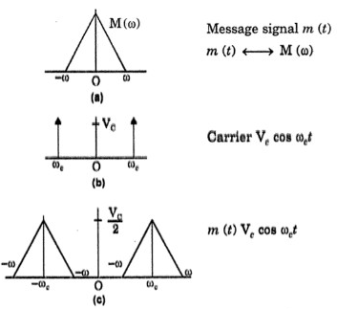
Intro to Basic Comm. Systems….Modulation
Why perform (advantages of) modulation ?
Frequency Translation
In radio broadcasting, audio signals can occupy the same band without mixing due to modulation or frequency conversion
Through this, the audio signal can be listened to at different frequencies
The translation is done simply by multiplying the message signal m(t) with the carrier signal to produce a translated signal
Frequency Translation

Slide 8
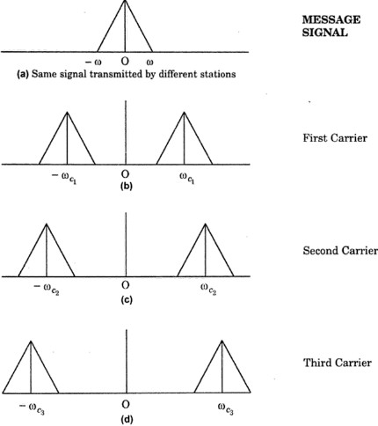
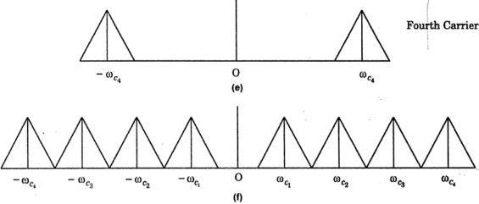
Frequency Division Multiplexing (FDM)
Now that many audio signals can be shifted at different locations in the bandwidth through translation
They can be easily sent on a single channel without mixing or overlapping with each other
Multiplexing helps make good use of the spectrum without wastage
Radio stations 1, 2, 3, and 4 can transmit on carriers Vcosωc1t, Vcosωc2t, Vcosωc3t, and Vcos ωc4t
Frequency Division Multiplexing (FDM)

Slide 9
Practicability of Antenna size
For proper transmission and reception of signal, the antenna size should be comparable to the wavelength (frequency) of the signal
Baseband frequencies make realizing antennas very impractical.
For example, If we transmit a baseband voice frequency of 30 Hz, the antenna size/aperture required to transmit is impractical, compared to when a higher frequency is used

Slide 10
Noise reduction
Without modulation, an audio signal, transmitted to a receiver will encounter a lot of other audio signals (people, machines) in the transmission medium.
With modulation, the carrier signal of high power and high frequency and will not be easily interfered with. It can also travel a long distance
Narrow Banding
With modulation, several audio signals at different frequencies can be transmitted with the same antenna.
Otherwise, each specific audio frequency will require a separate antenna

